Slide 1

Module 1
Regression Basics
Notes:
Guidelines
Use section headers to chunk content in your presentation.
Use the same style of section header throughout your presentation.
Keep your title to no more than 2 lines.

Slide 2
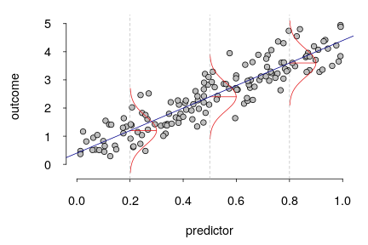
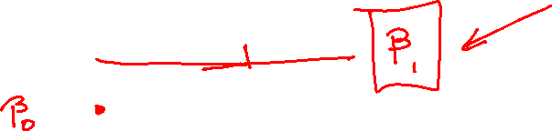
Inference on the Slope
Notes:
Guidelines
Use a title slide at the beginning of your presentation. There are 9 variations of title slides to choose from.
If you will have a series of slideshows, we recommend using the same style of title slide for each presentation.
Keep your title to no more than 2 lines.
Do not change the font style or font size of the title or subtitle.

Slide 3
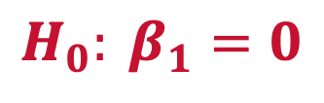
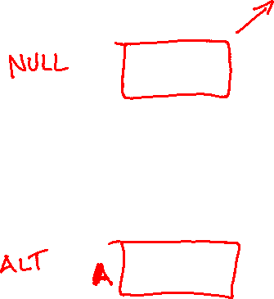
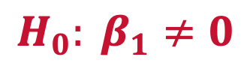
Hypothesis Tests on the Slope
We assume
Unless we have sufficient evidence to show that
$$H_{0}: β_{1}=0$$
No linear relationship between Cost and Earnings
$$H_{0}: β_{1}≠0$$
Linear relationship between Cost and Earnings

Slide 4
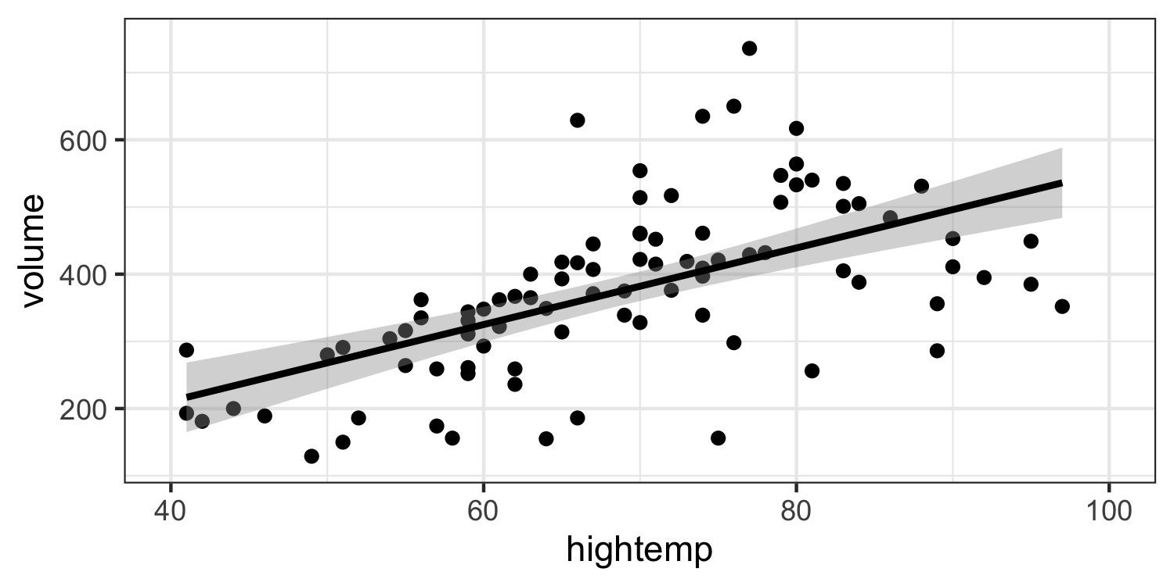

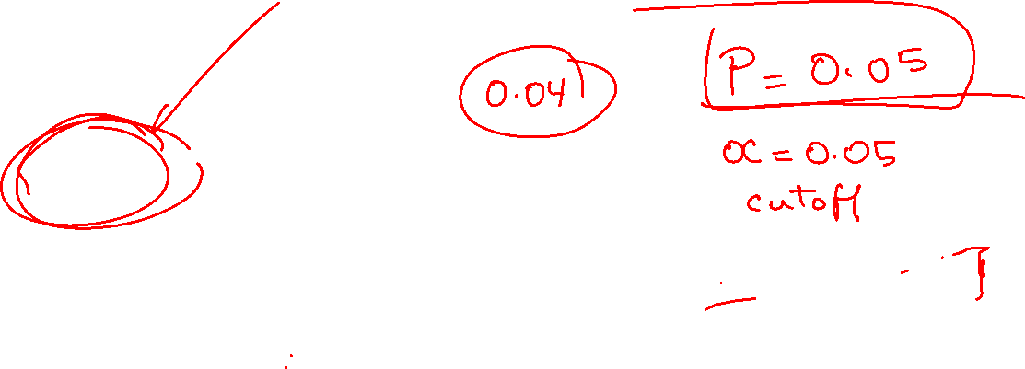

Hypothesis Tests on the Slope
The slope $β_{1}=0$ means that regardless of the value $x$, $y$ will on average be the same
$$β_{1}=0$$

Slide 5
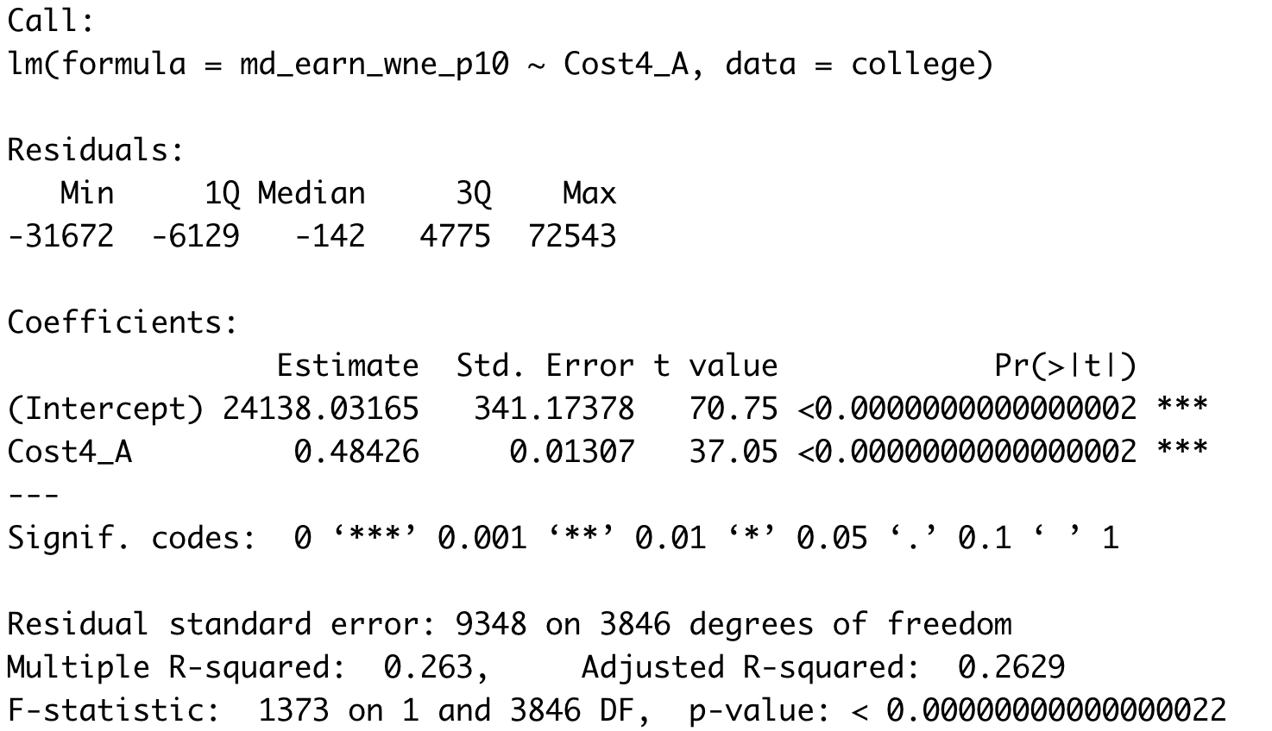
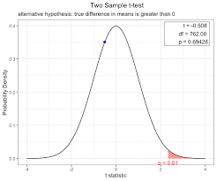



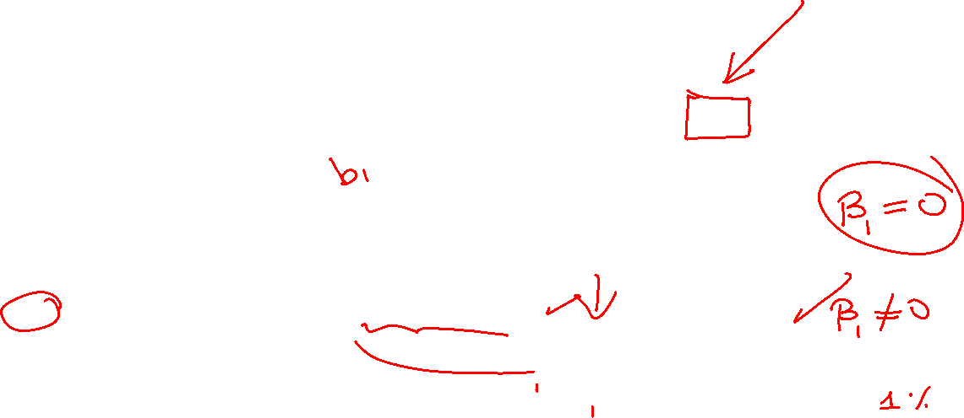
How Do We Get Evidence Against $H_{0}$?
If the sample slope ${\hat{β}}_{1}$ is far away from zero
However, we have to standardize the value
$$t=\frac{b_{1}−0}{s_{b_{1}}}$$

Slide 6

Practice

Slide 7
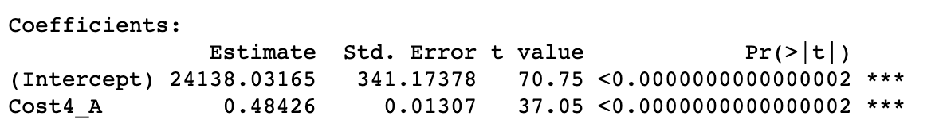
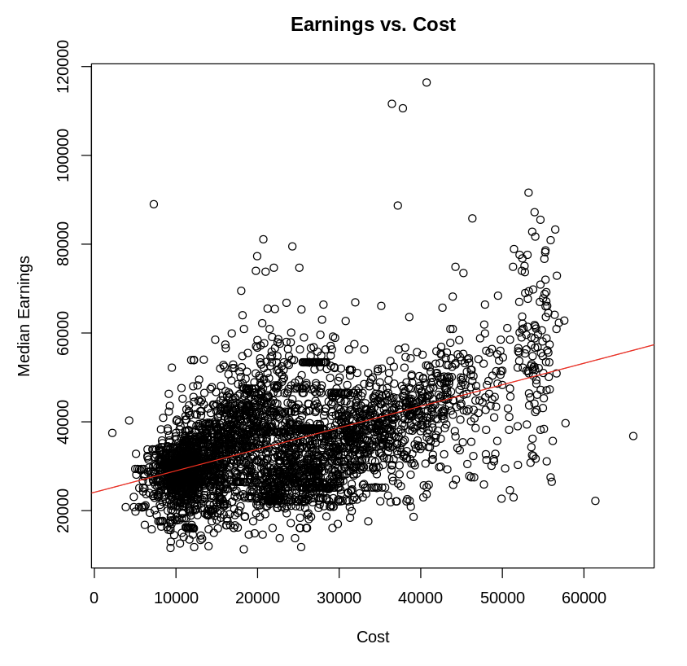
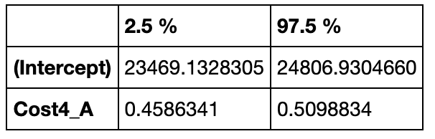


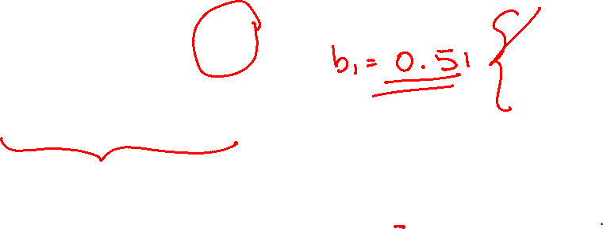

Confidence Interval on $β_{1}$
We can construct a confidence interval on $β_{1}$
95% CONFIDENCE INTERVAL ON $β_{1}$

Slide 8
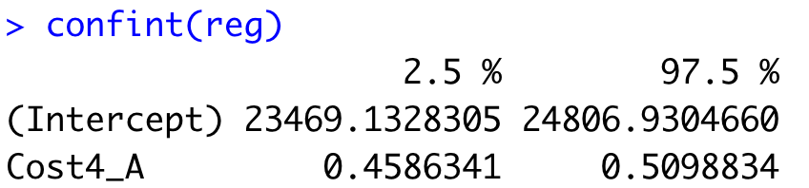
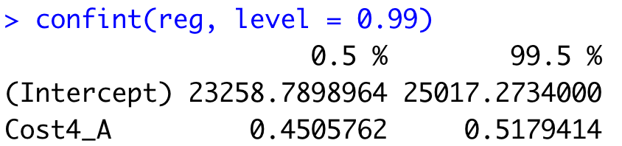


Confidence Interval on $β_{1}$
We can construct a confidence interval on $β_{1}$
95% CONFIDENCE INTERVAL ON $β_{1}$
99% CONFIDENCE INTERVAL ON $β_{1}$

Slide 9
Practice

Slide 10
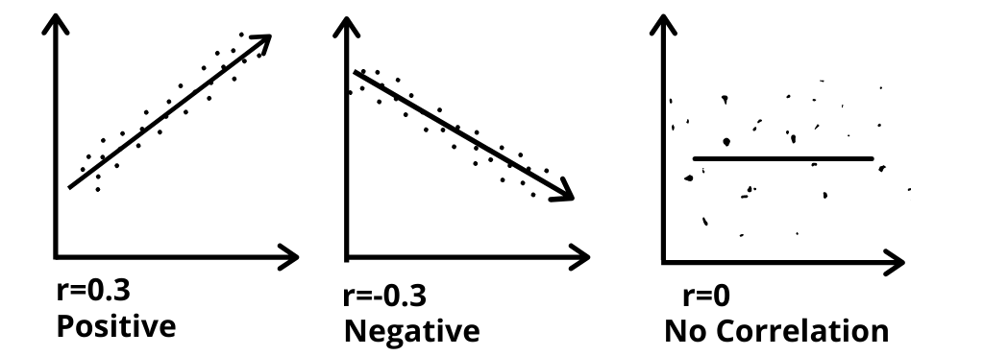
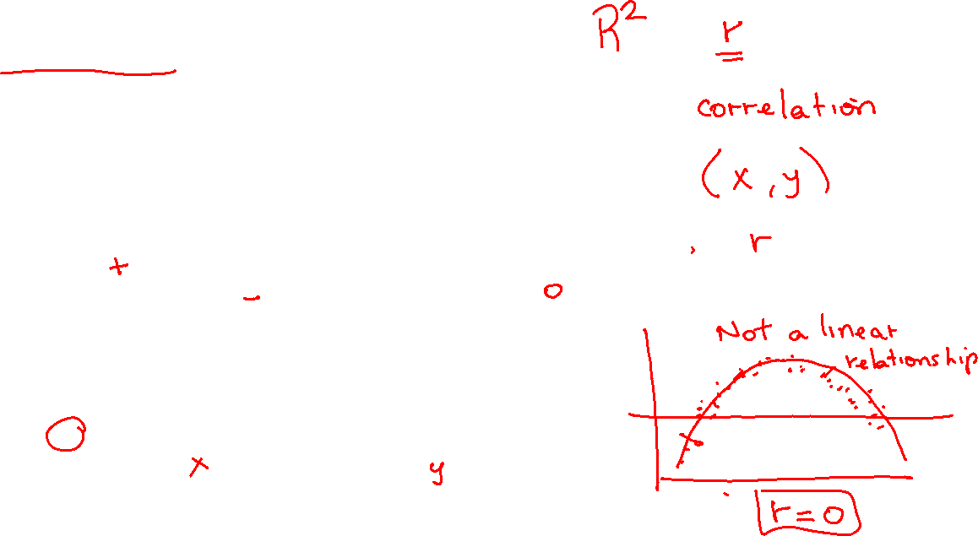

Correlation Coefficient
Measures linear relationship

Slide 11
Practice

Slide 12
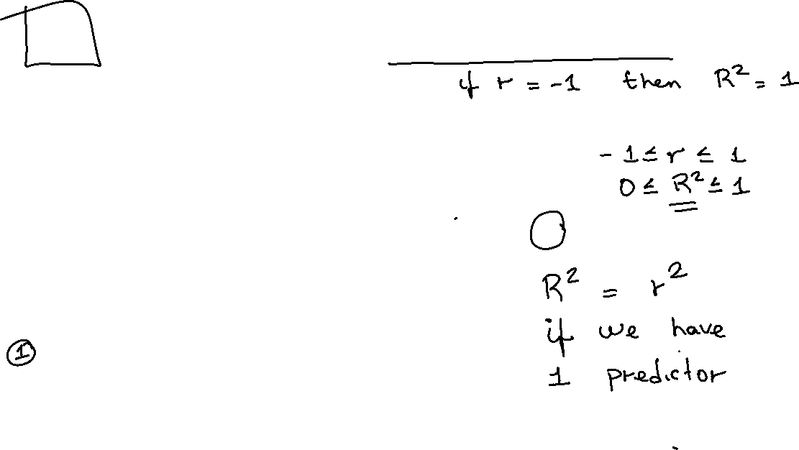
R2 (Coefficient of Determination)
For Simple Linear Regression, it is the squared value of the correlation coefficient
R²

Slide 13
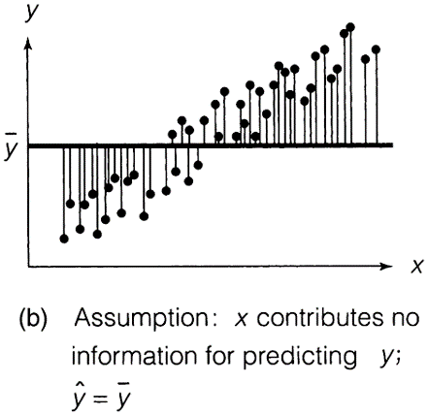
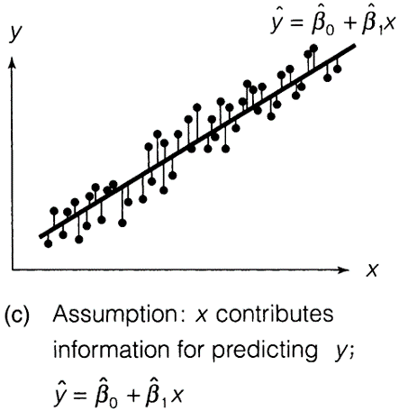
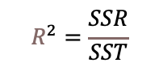
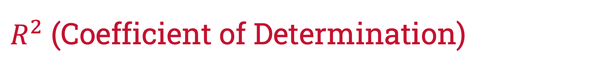

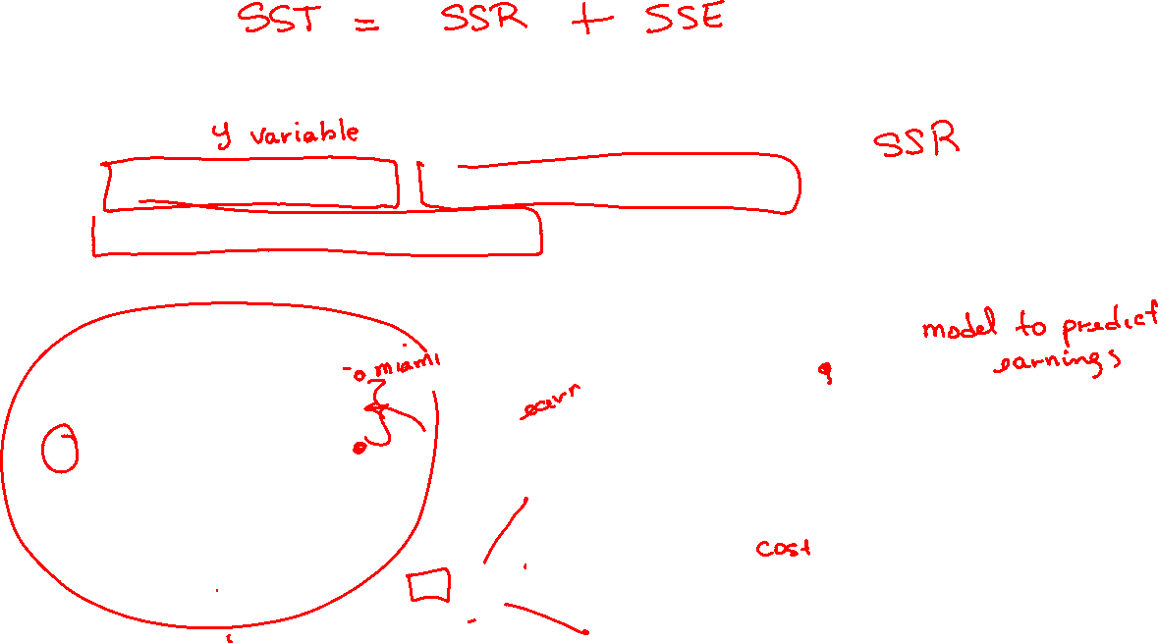

$R^{2}$ (Coefficient of Determination)
SST: total variation, SSR: Explained Variation,
SSE: unexplained variation
$R^{2}$ is the ratio is the ratio of explained variation to total variation
TOTAL VARIATION OF Y (SST)
$$R^{2}=\frac{SSR}{SST}$$
SUMS OF SQUARED ERRORS (SSE)
$SSR$ = $SST−SSE$

Slide 14
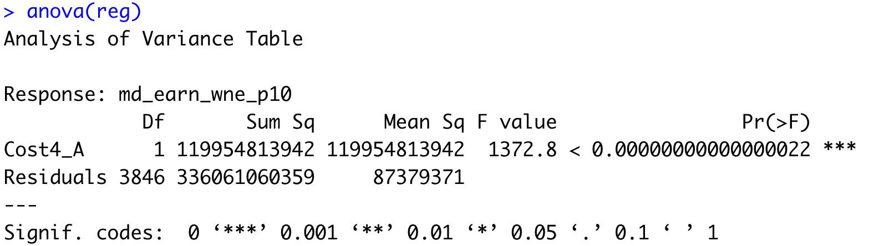
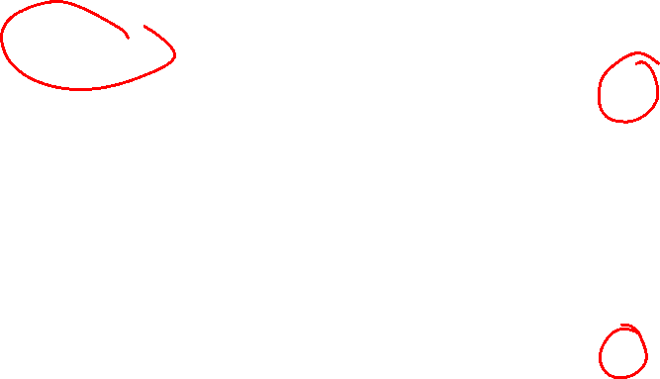
$R^{2}$ (Coefficient of Determination)
SST: total variation, SSR: Explained Variation,
SSE: unexplained variation
$R^{2}$ is the ratio is the ratio of explained variation to total variation
SSR
SSE

Slide 15
Practice

Slide 16
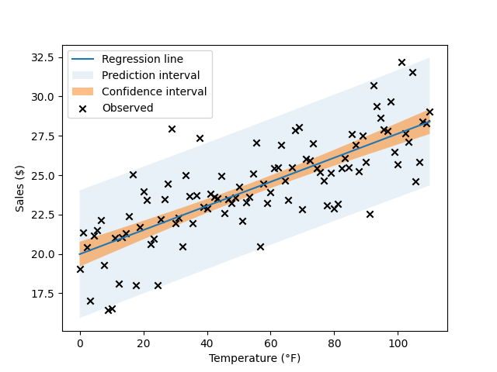

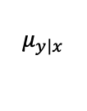

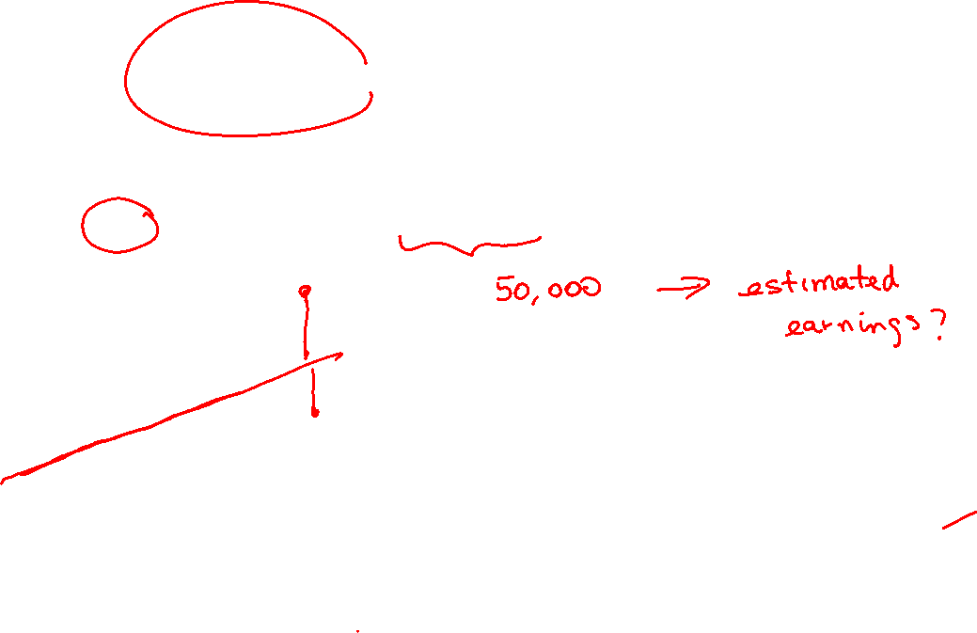
Point Estimates
A point estimate refers to the prediction of $y$ for a given value of $x$.
$$\hat{y}$$
estimates
$$μ_{y\left|x\right.}$$

Slide 17

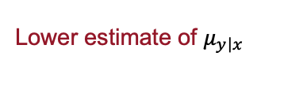



Confidence Interval on $μ_{y\left|x\right.}$
A confidence interval is a range for the average value of $y$ for a given value of $x$.
Upper estimate of $μ_{y\left|x\right.}$
Lower estimate of $μ_{y\left|x\right.}$

Slide 18


Prediction Interval on $y$
A confidence interval is a range for the average value of $y$ for a given value of $x$.
Upper prediction for y
Lower prediction for y

Slide 19
Practice

Slide 20
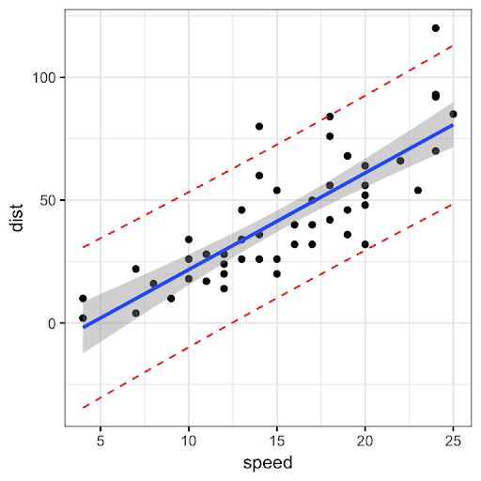
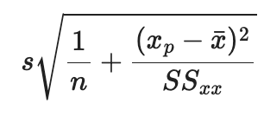

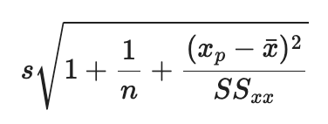
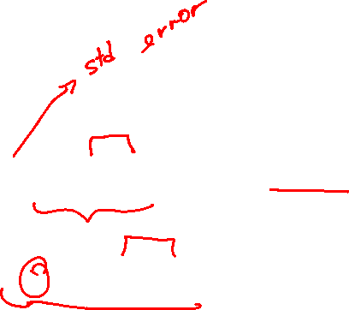
Confidence vs Prediction Interval
Standard error for confidence interval
Standard error for prediction
confidence
prediction

Slide 21
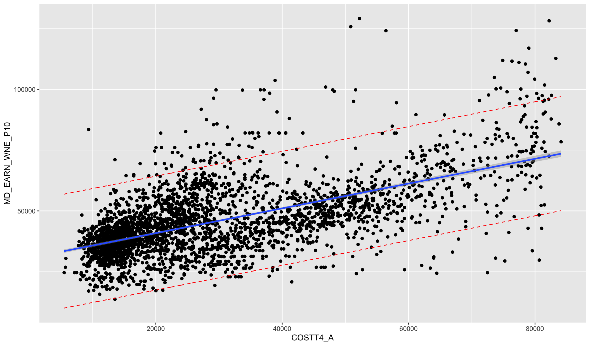
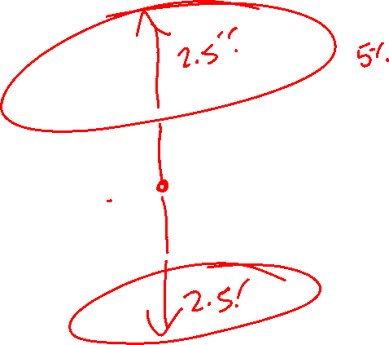
Confidence vs Prediction Interval
Standard error for confidence interval
Standard error for prediction
confidence
prediction

